Slide 1
Project review
ANOOJA S ANIYAN

Slide 2
CONTENTS
Project title
Relevance of the topic
Description of the topic
Objective of the study
Existing system and proposed system
Input/output modules identified
System design or Algorithms used
Datasets

Slide 3
Patient DOCTOR CHAIN

Slide 4
RELEVANCE OF THE TOPIC
Without proper data management, no one would be able to access or decipher the information they need to properly treat their patients.
So, we use things like Electronic Health Records to improve patient care and health care customer relationship management systems to improve patient relationships

Slide 5
DESCRIPTION OF THE TOPIC
Patient data management systems (PDMS), are innovative computer systems, which attempt to integrate administrative functions and clinical decision making.

Slide 6
OBJECTIVE OF THE TOPIC
Design a system for better patient care
Store and view all medical documents securely

Slide 7
Existing system
A PDMS is a software based system containing information such as patient identification, vital intensive care parameters and other documented clinical observations

Slide 8
Proposed system
Has 2 main users
1.Patient
2.Doctor
Patients can:
Upload a document to the blockchain
View the uploaded documents
Analyses the uploaded document
Add a trusted doctor to view medical documents

Slide 9
Doctors can:
Upload a medical document about a certain patient to the blockchain
View a certain patients uploaded documents

Slide 10
MODULES
Patient Registration
Doctor login
Analysis

Slide 11
DATASET
Uses the medical reports like blood test report, sugar test report etc

Slide 12
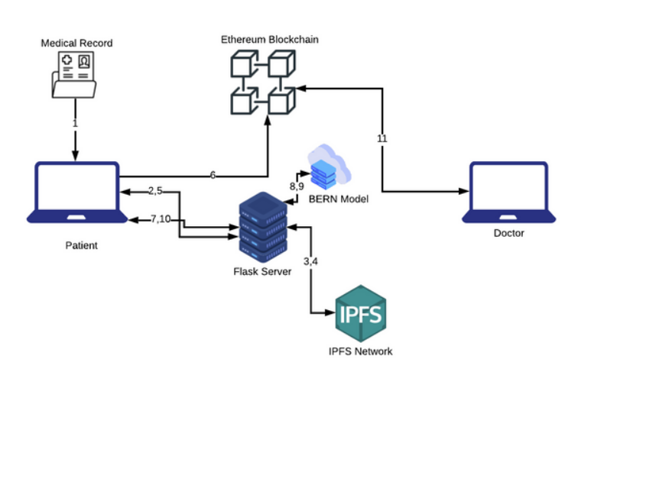
System design

Slide 13
ReactJS, Flask, Solidity, IPFS and the Ethereum Blockchain
Ethereum is an open source, public, blockchain-based distributed computing platform and operating system featuring smart contract functionality.
The InterPlanetary File System is a protocol and peer-to-peer network for storing and sharing data in a distributed file system. IPFS uses content-addressing to uniquely identify each file in a global namespace connecting all computing devices.

Slide 14
THANKYOU

